Slide 1
HPC Labs – #2 Assignment
High-Performance Computing
Authors
MATTEO PINTAUDI
LORENZO VENTURELLI
ALI JAOUADI

Slide 2
Brief description of the application
Covariance application
What is Covariance Matrix?
Covariance matrix is a square matrix that displays the variance exhibited by elements of datasets and the covariance between a pair of datasets. Variance is a measure of dispersion and can be defined as the spread of data from the mean of the given dataset. Covariance is calculated between two variables and is used to measure how the two variables vary together.

Slide 3
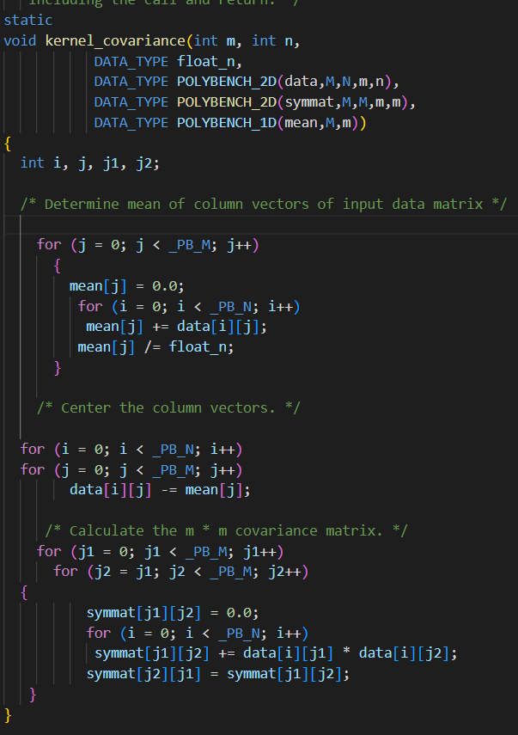
The target function in the application
Kernel_covariance it’s the most important function in the application so in the first stage we ran the function on the host in parallel, then we ran the function on the device in CUDA then we compare the execution time and the speedup of the two methods

Slide 4
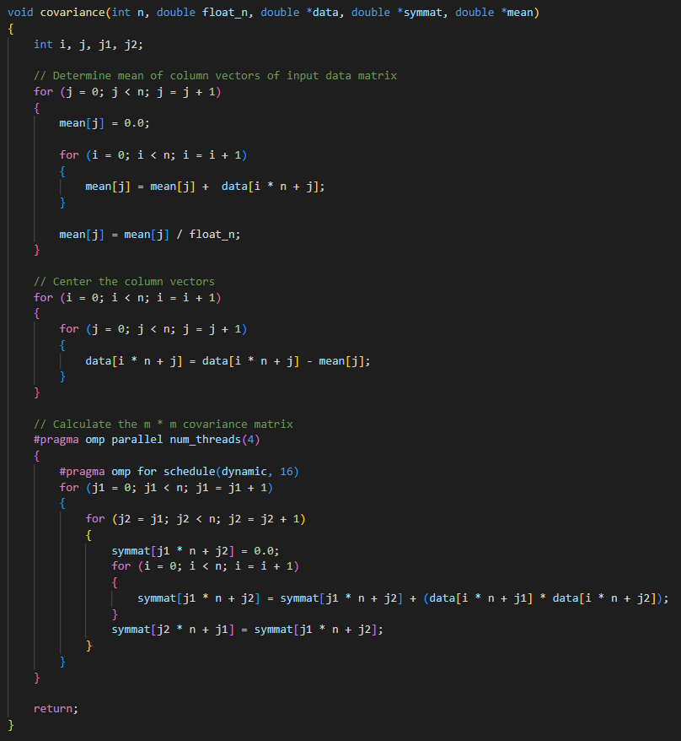
Parallelization of the covariance function on the host

Slide 5
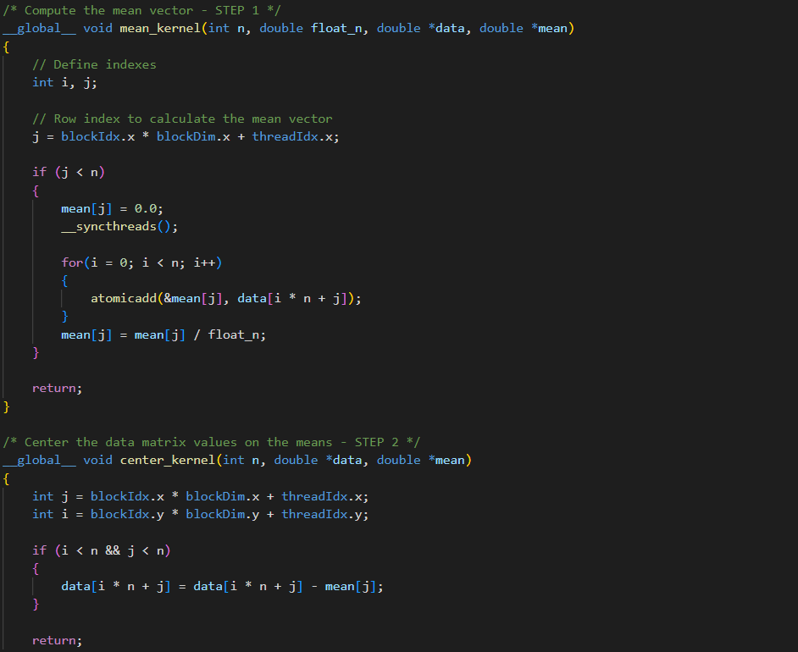
On the device
We have split the covariance function into three functions they are run on the device

Slide 6
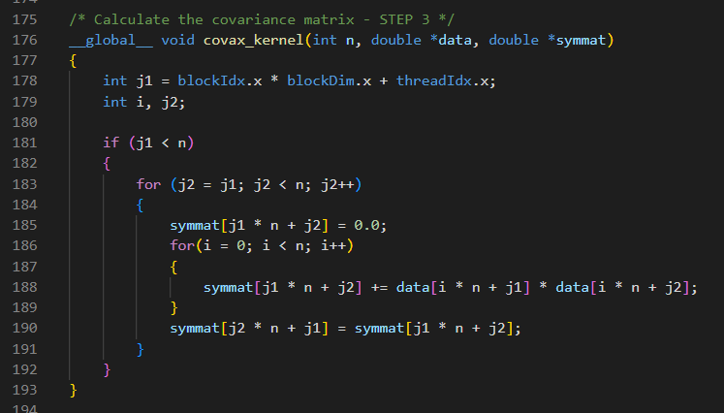

Slide 7
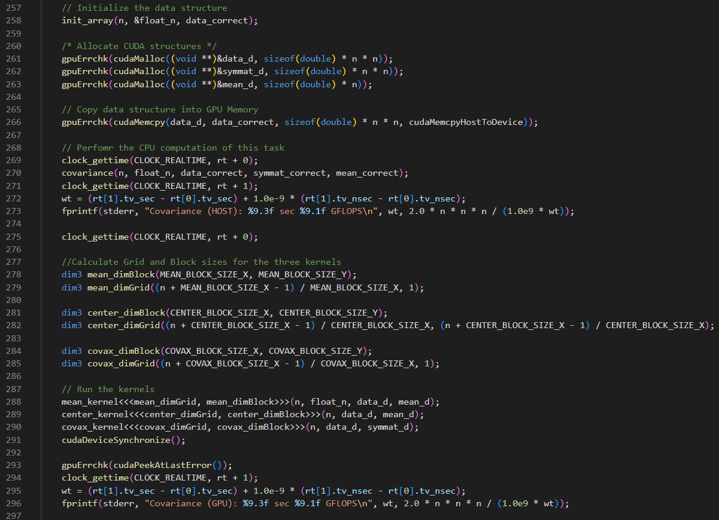
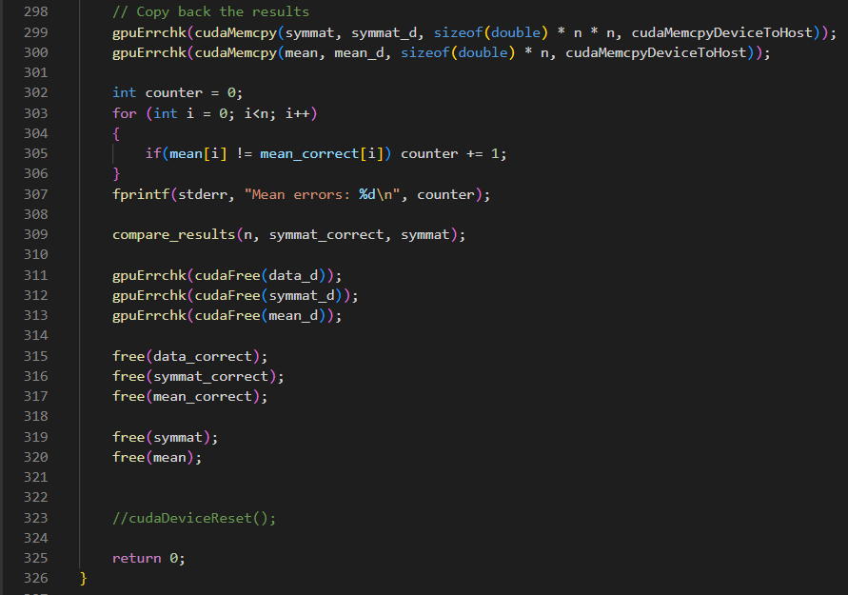
Main

